Slide 1
Waveshaping Synthesis
Also called “nonlinear distortion”
Originally developed by J. C. Risset, later refined by Arfib and LeBrun
Involves modifying (distorting) an audio signal by means of a “transfer function”
Achieves results comparable to FM, in terms of its efficiency and its ability to create dynamic changes in timbre

Slide 2
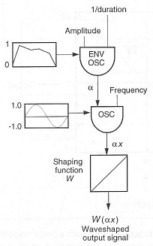
A Basic Design
The output of an oscillator is used an index into a table containing a transfer function. An envelope is used on the amplitude input to the oscillator, which dynamically controls the range of values retrieved from the table. [Diagram from C. Roads]

Slide 3
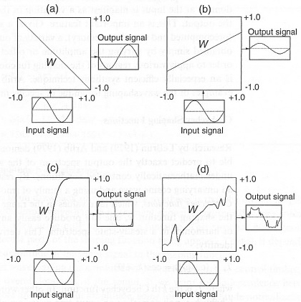
Transfer Functions With Outputs
Depending on the transfer function, waveshaping can modify an input signal in various ways. Here, a pure sine wave is: (a) inverted, (b) attenuated, (c) clipped, and (d) radically altered.
[From C. Roads]

Slide 4
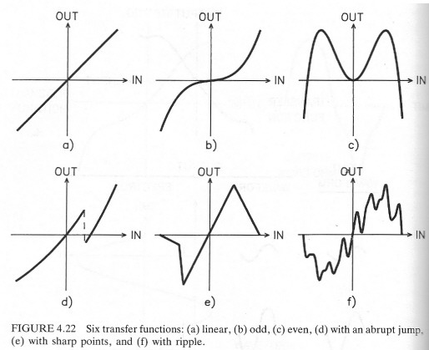
Example Transfer Functions
A linear function (a) will not change the output spectrum, but non-linear functions will.
A function symmetrical around the origin will generate only odd harmonics; one that is symmetrical around the vertical axis will only produce even harmonics.
Jagged functions may cause aliasing.
[Dodge/Jerse]

Slide 5
Creating Transfer Functions
Transfer functions can be created in a variety of ways, including drawing them.
However, to create a transfer function that will have a limited and predictable output spectrum, it is best to use polynomials.
A polynomial of the following form will produce no harmonics above the Nth:
F(x) = d₀ + d₁x + d₂x² + … + d_{N}x^{N}

Slide 6
Chebyshev Polynomials
Useful for creating transfer functions that will produce specific harmonic partials at specific relative amplitudes, if the entire function is being referenced by an input sine wave
A Chebyshev polynomial of the k^{th} order will produce only the k^{th} harmonic
Chebyshev polynomials of various orders can be summed to create a transfer function that will generate a precise harmonic spectrum

Slide 7
Special Gen Subroutines
Csound provides several special Gen Subroutines for use in waveshaping:
  Gen 3 – general polynomials in x
  Gen 13 – Chebsyhev polynomials of 1st kind
  Gen 14 – Chebyshev polynomials of 2nd kind
  Gen 4 – normalization functions

Slide 8
Implementation in Csound
There is no waveshaping opcode in Csound. Instead, we implement it using a table with a normalized index and an offset of .5. E.g.,
kamp linen .499, irise, idur, idecay
aindex oscili kamp, icps, isinefn
awsig tablei aindex, iwsfn, 1, .5
Note that the peak value of linen is set to .499, which ensures that the offset index into table will never quite reach 0 or 1.

Slide 9
Using Normalization Functions
Output amplitude of a waveshaper depends heavily on index
  Small indices may produce very low amplitudes and/or DC bias
Normalization functions compensate
  Use Gen04 to create
  Typically ½ size of waveshaping function
  Use WS Index as pointer

Slide 10
Gen04
Syntax
f # time size 4 source# sourcemode
Initialization
size -- number of points in the table. Should be power-of-2 plus 1. Must not exceed (except by 1) the size of the source table being examined; limited to just half that size if the sourcemode is of type offset (see below).
source # -- table number of stored function to be examined.
sourcemode -- a coded value, specifying how the source table is to be scanned to obtain the normalizing function. Zero indicates that the source is to be scanned from left to right. Non-zero indicates that the source has a bipolar structure; scanning will begin at the mid-point and progress outwards, looking at pairs of points equidistant from the center.

Slide 11
Example Csound Code
kenv linen p4,irise,idur,idecay
kamp linen .499, irise, idur, idecay
aindex oscili kamp, icps, isinefn
awsig tablei aindex, iwsfn, 1, .5
knorm tablei kamp, inormfn,1
asig = awsig*knorm
out asig*kenv

Slide 12
Reading
Dodge Chapter 4, pp. 128 – 142
Roads, pp. 252 – 261
Boulanger, pp. 243 - 249

